Slide 1


SAD162
Human-Computer Interaction
Testing and Evaluation
Mohammed Al-Husban

Slide 2

Evaluation
  tests usability and functionality of system
  occurs in laboratory, field and/or in collaboration with users
  evaluates both design and implementation
  should be considered at all stages in the design life cycle

Slide 3

assess extent of system functionality
assess effect of interface on user
identify specific problems

Slide 4

Cognitive Walkthrough
Heuristic Evaluation
Review-based evaluation

Slide 5

Proposed by Polson et al.
  evaluates design on how well it supports user in learning task
  usually performed by expert in cognitive psychology
  expert ‘walks though’ design to identify potential problems using psychological principles
  forms used to guide analysis

Slide 6

For each task walkthrough considers
  what impact will interaction have on user?
  what cognitive processes are required?
  what learning problems may occur?
Analysis focuses on goals and knowledge: does the design lead the user to generate the correct goals?

Slide 7

Proposed by Nielsen and Molich.
usability criteria (heuristics) are identified
design examined by experts to see if these are violated
Example heuristics
  system behaviour is predictable
  system behaviour is consistent
  feedback is provided
Heuristic evaluation `debugs' design.

Slide 8

Simple and natural dialogue
Speak the users’ language
Minimize the users’ memory load
Consistency
Feedback
Clearly marked exits
Shortcuts
Precise and constructive error messages
Prevent errors
Help and documentation

Slide 9

Results from the literature used to support or refute parts of design.
Care needed to ensure results are transferable to new design.
Model-based evaluation
Cognitive models used to filter design options
  e.g. GOMS prediction of user performance.
Design rationale can also provide useful evaluation information

Slide 10


Slide 11

Advantages:
  specialist equipment available
  uninterrupted environment
Disadvantages:
  lack of context
  difficult to observe several users cooperating
Appropriate
  if system location is dangerous or impractical for constrained single user systems to allow controlled manipulation of use

Slide 12

Advantages:
  natural environment
  context retained (though observation may alter it)
  longitudinal studies possible
Disadvantages:
  distractions
  noise
Appropriate
  where context is crucial for longitudinal studies

Slide 13

Requires an artefact:
simulation, prototype,
full implementation

Slide 14

controlled evaluation of specific aspects of interactive behaviour
evaluator chooses hypothesis to be tested
a number of experimental conditions are considered which differ only in the value of some controlled variable.
changes in behavioural measure are attributed to different conditions

Slide 15

Subjects
  who – representative, sufficient sample
Variables
  things to modify and measure
Hypothesis
  what you’d like to show
Experimental design
  how you are going to do it

Slide 16

independent variable (IV)
  characteristic changed to produce different conditions
  e.g. interface style, number of menu items
dependent variable (DV)
  characteristics measured in the experiment
  e.g. time taken, number of errors.

Slide 17

prediction of outcome
  framed in terms of IV and DV
  e.g. “error rate will increase as font size decreases”
null hypothesis:
  states no difference between conditions
  aim is to disprove this
  e.g. null hyp. = “no change with font size”

Slide 18

within groups design
  each subject performs experiment under each condition.
  transfer of learning possible
  less costly and less likely to suffer from user variation.
between groups design
  each subject performs under only one condition
  no transfer of learning
  more users required
  variation can bias results.

Slide 19

Before you start to do any statistics:
  look at data
  save original data
Choice of statistical technique depends on
  type of data
  information required
Type of data
  discrete - finite number of values
  continuous - any value

Slide 20

parametric
  assume normal distribution
  robust
  powerful
non-parametric
  do not assume normal distribution
  less powerful
  more reliable
contingency table
  classify data by discrete attributes
  count number of data items in each group

Slide 21

What information is required?
  is there a difference?
  how big is the difference?
  how accurate is the estimate?
Parametric and non-parametric tests mainly address first of these

Slide 22
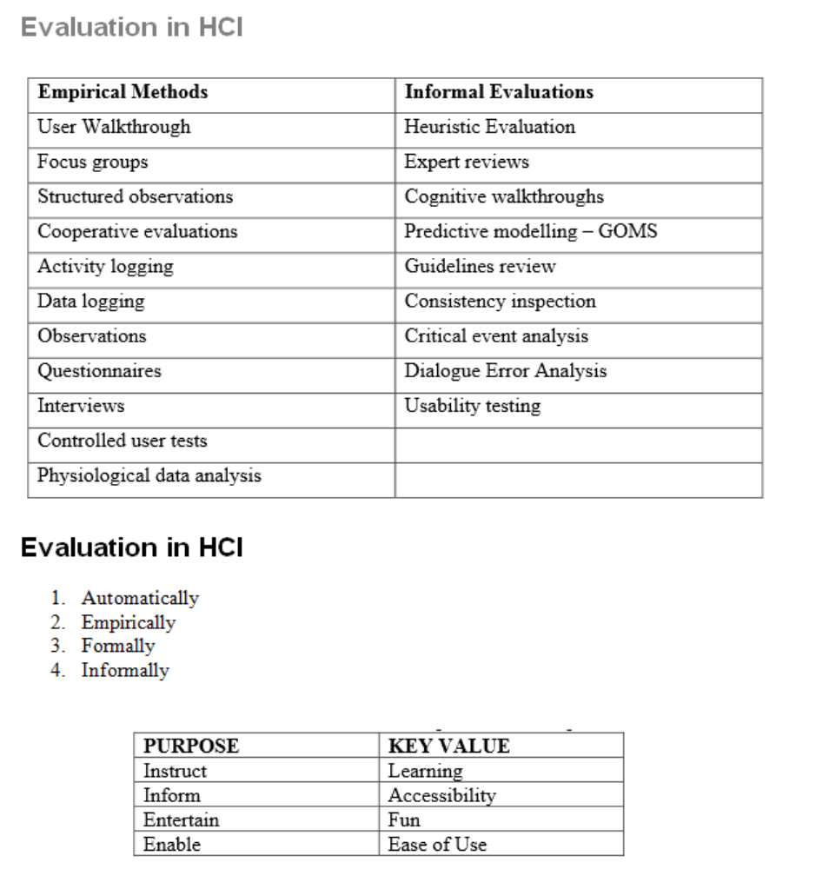

Slide 23
